Slide 1
Arrange Chairs around a Table using SPOT Robot Capstone Project for Fall 2025
Siddharth Senthilnathan

Slide 2
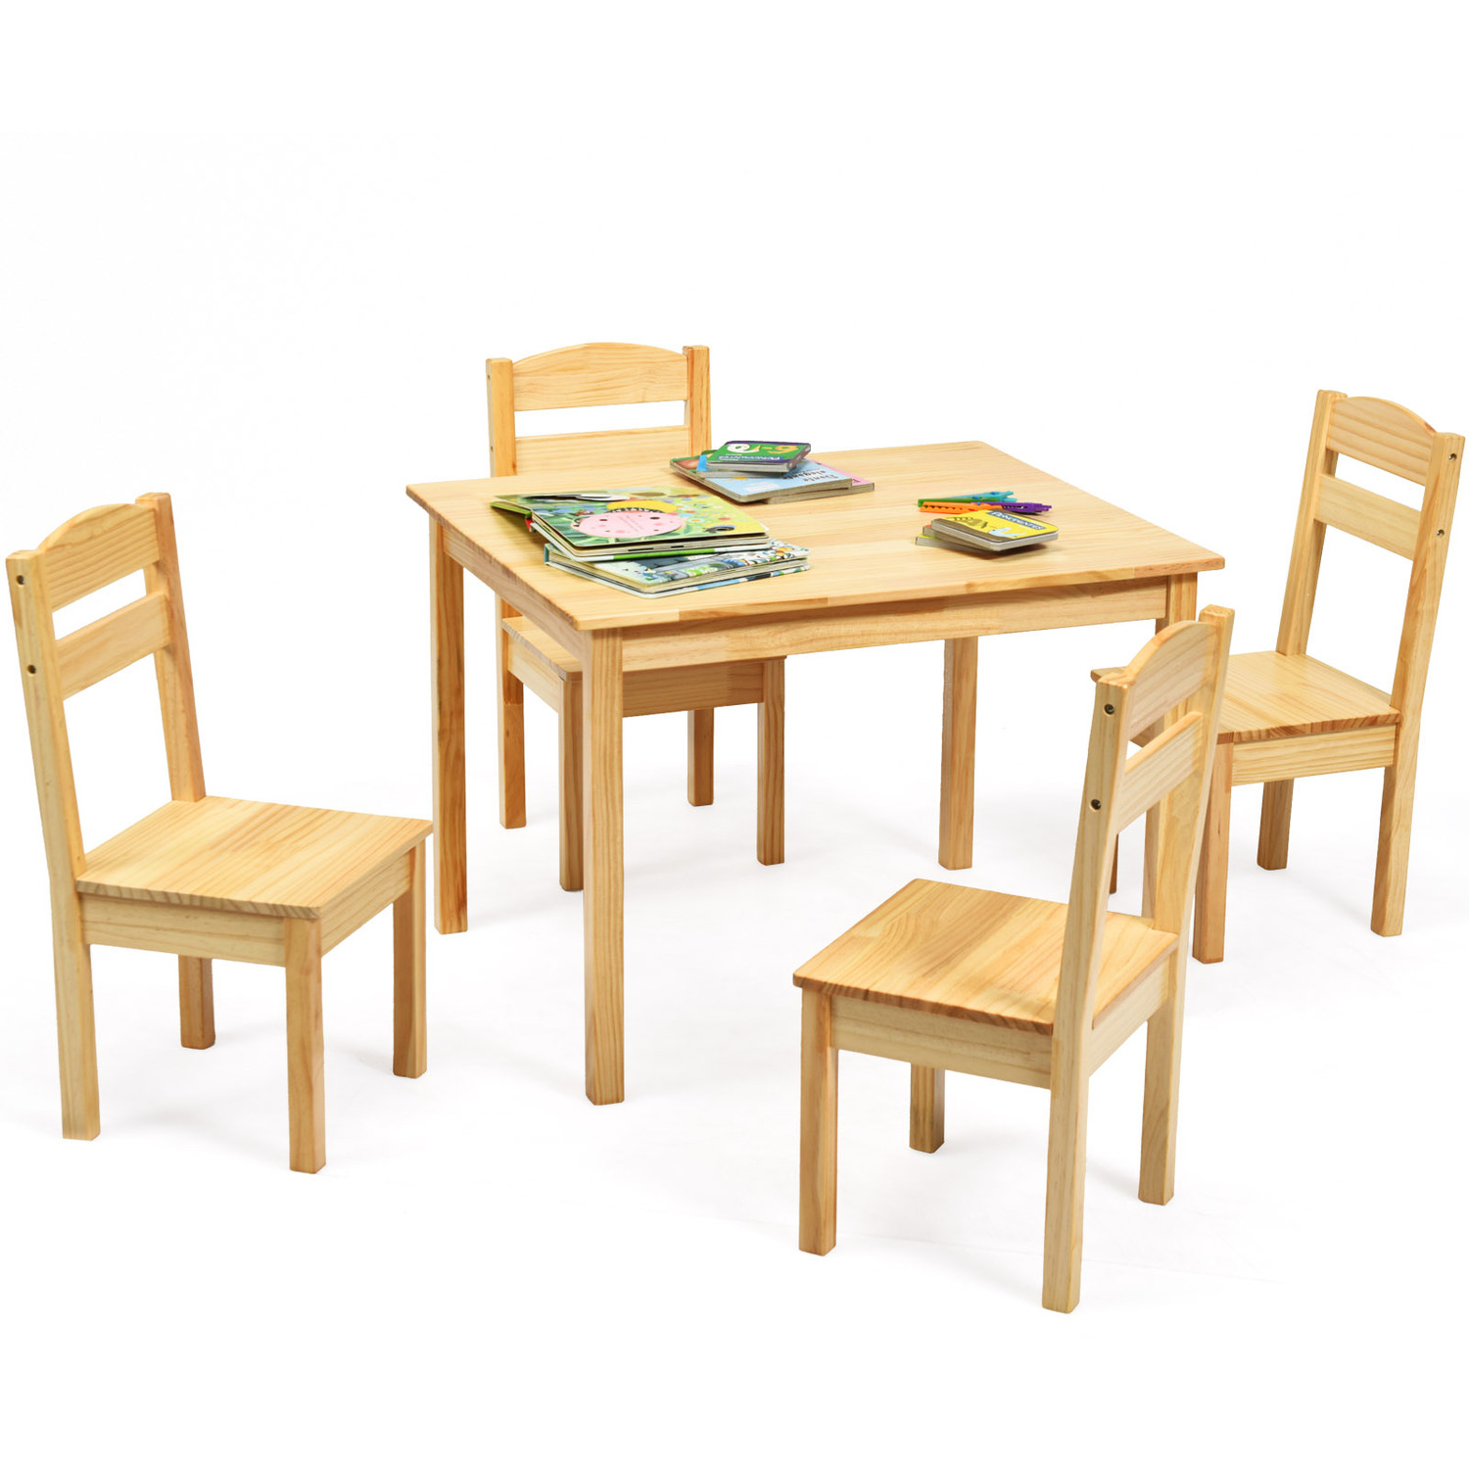
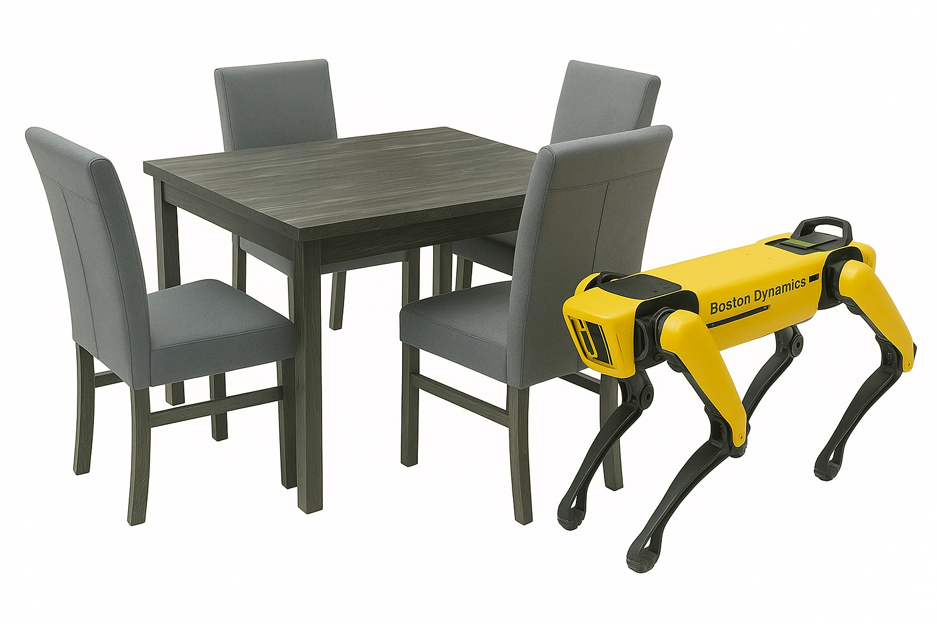
Objective
Initial Configuration
Final Configuration

Slide 3
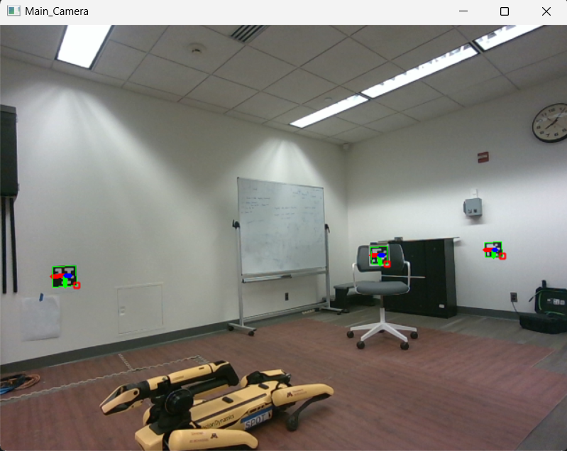
Environment Setup

Slide 4
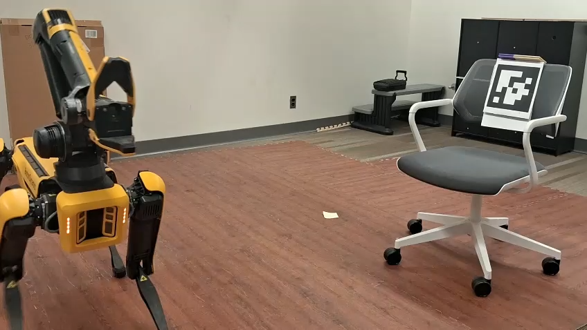
Progress

